Slide 1


Traffic Telligence: Advanced Traffic Volume Estimation with Machine Learning

Slide 2
Team Information
Student Name | Roll Number
Nandanavanam Nikhil(Leader) | 22AK1A3061
Shaik Naseer Hussain | 22AK1A3058
Praveen Kumar | 23AK5A3007
Kethineni Nikitha | 22AK1A3063

Slide 3

CONTENTS
1. INTRODUCTION
2. IDEATION PHASE
3. REQUIREMENT ANALYSIS
4. PROJECT DESIGN
5. PROJECT PLANNING & SCHEDULING
6. FUNCTIONAL AND PERFORMANCE TESTING
7. RESULTS
8. ADVANTAGES & DISADVANTAGES
9. CONCLUSION
10. FUTURE SCOPE
11. APPENDIX

Slide 4
01
INTRODUCTION

Slide 5

INTRODUCTION
Project Overview
Purpose

Slide 6

Project Overview
“Traffic Telligence” is an advanced machine learning system designed to estimate and forecast traffic volume. By integrating real-time video feeds, weather data, and historical patterns, the system offers accurate traffic predictions, reducing congestion and supporting smart city infrastructure.

Slide 7

Purpose
The primary objective is to build a predictive and scalable ML-based system to help authorities and commuters make informed traffic decisions. The project provides a low-cost alternative to traditional sensor-based monitoring.

Slide 8

02
IDEATION PHASE

Slide 9

IDEATION PHASE
Problem Statement
Empathy Map Canvas
Brainstroming Highlights

Slide 10
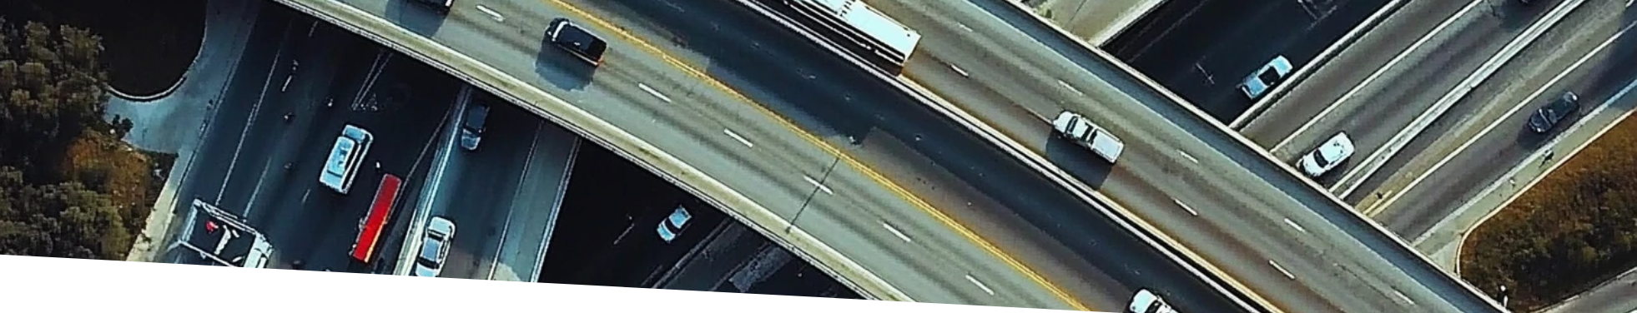
Problem Statement
Urban areas face excessive congestion, leading to lost productivity, emissions, and ineffective traffic management. Current systems lack predictive intelligence and integration with external influencing factors.

Slide 11




Empathy Map Canvas
Users
Pains
Needs
Gains
Traffic authorities, city planners, daily commuters, logistics providers
Delays, unpredictability, environmental impact
Timely predictions, optimized traffic routes, real-time decision making
Time and fuel savings, efficient planning, better quality of life

Slide 12



Brainstorming Highlights
Prediction Models
2
Leverage powerful regression models for accurate predictions
Data Utilization
Utilize structured data from multiple sources (weather, events, holidays)
1
Web-based Solution
3
Web-based solution accessible from any device

Slide 13

03
REQUIREMENT ANALYSIS

Slide 14

REQUIREMENT ANALYSIS
Customer Journey Map
Solution Requirements
Data Flow Diagram
Technology Stack

Slide 15

Customer Journey Map
Login/Register → Input Parameters → Prediction Generated → Result Displayed

Slide 16

Solution Requirements
Dataset
Models
traffic volume.csv
XGBoost, Random Forest, LightGBM
Web frontend
Authentication
for user input and result visualization
OTP-based user authentication

Slide 17


Data Flow Diagram
1
2
3
4
User Input
Data Processing
Prediction Generation
Output Display
User submits input
Backend Flask API processes data
Output displayed on UI
ML model generates prediction

Slide 18



Technology Stack
Languages
Libraries
Framework
Python, HTML, CSS, JavaScript
Pandas, NumPy, Scikit-learn, XGBoost
Flask (API + Web Interface)
Database
Tools
MongoDB (planned)
VS Code, GitHub

Slide 19

04
PROJECT DESIGN

Slide 20

PROJECT DESIGN
Problem-Solution Fit
Solution Architecture
Proposed Solution
UML Diagrams
Model Overview

Slide 21

Problem-Solution Fit
The solution fits urban mobility needs by transforming static traffic monitoring into proactive prediction using ML.

Slide 22

Proposed Solution
A multi-module system with:
User Interface
Flask Backend
Model Training
Web-based user interface
Flask backend with ML prediction API
Model trained and serialized using Pickle/Joblib

Slide 23
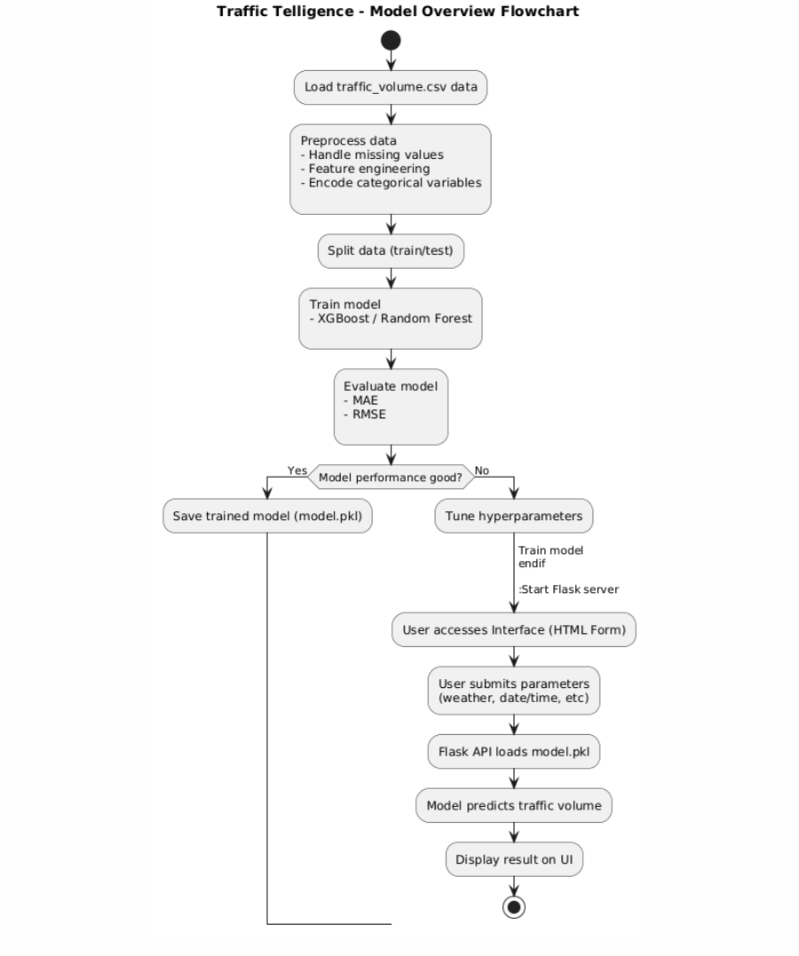
Solution Architecture
Frontend (HTML Forms) → Flask API → Pre-trained Model → Output to Dashboard
Templates used: login.html, interface.html, result.html
Encoders handle categorical inputs for accurate modeling

Slide 24
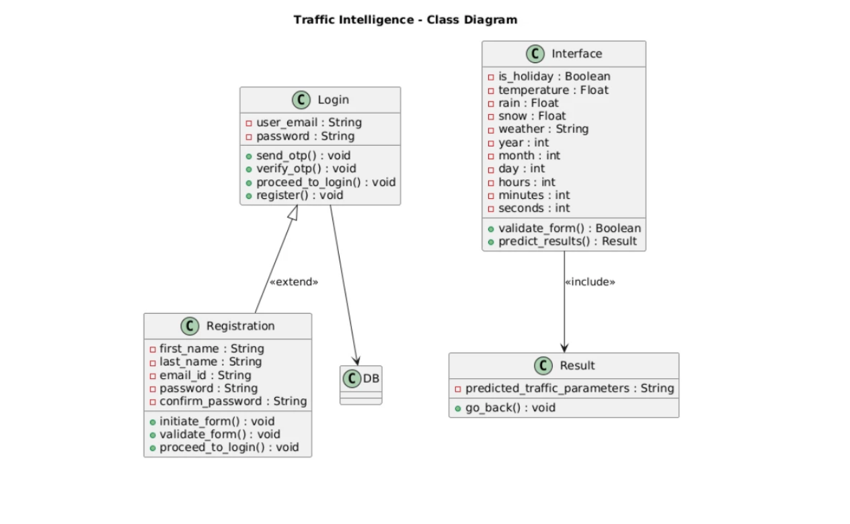
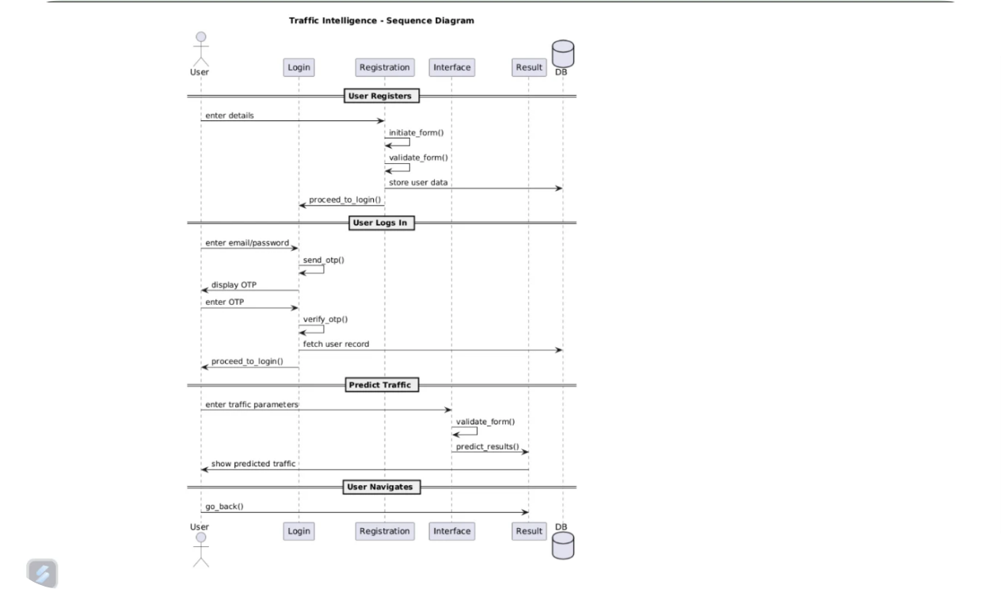
UML Diagrams
Class Diagram Sequence Diagram

Slide 25

Model Overview
Our prediction engine was built on historical traffic data, enriched with external features like weather and holidays. We implemented XGBoost and Random Forest Regressors, chosen for their speed and ability to handle large feature sets.
Key Highlights:
1
Features
2
Preprocessing
hour, day_of_week, is_holiday, temperature, precipitation
One-hot encoding, null handling
3
Evaluation
4
Final model
MAE, RMSE for performance validation
serialized with Pickle

Slide 26

05
PROJECT PLANNING & SCHEDULING

Slide 27

Agile Sprint Schedule
Sprint | Tasks
1 | Data collection and cleaning
2 | Model training and tuning
3 | Flask backend setup
4 | Frontend design
5 | Testing & bug fixing
6 | Final documentation & deploy

Slide 28

06
FUNCTIONAL AND PERFORMANCE TESTING

Slide 29

FUNCTIONAL AND PERFORMANCE TESTING
Testing Overview
Output Screens

Slide 30

Testing Overview
1
2
3
4
Model Verification
Performance Testing
Logic Fix
Security Integration
Verified consistent results across local and deployed models
Fixed logic discrepancy between local script and Flask API
Tested performance on edge cases and realistic data
Integrated OTP system for login security

Slide 31
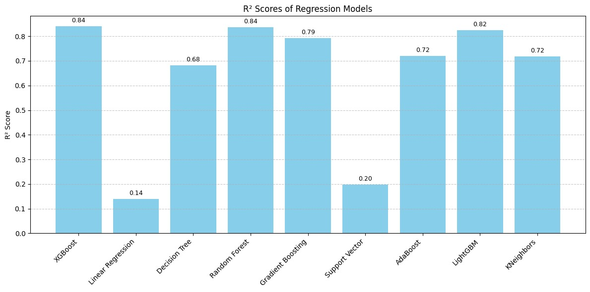
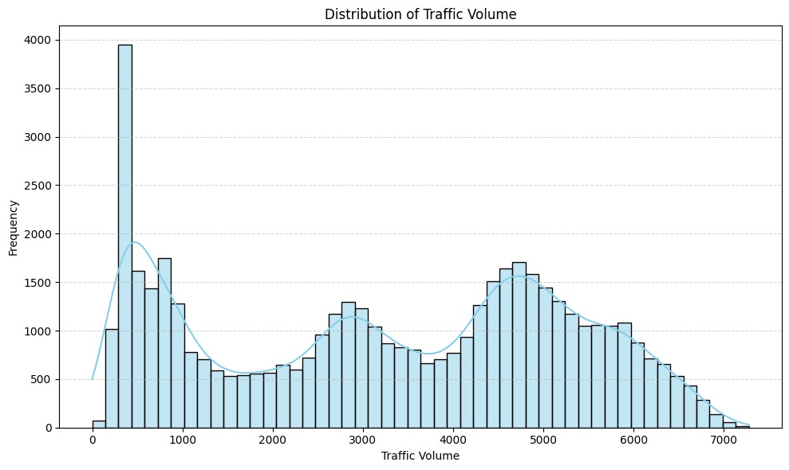

Slide 32
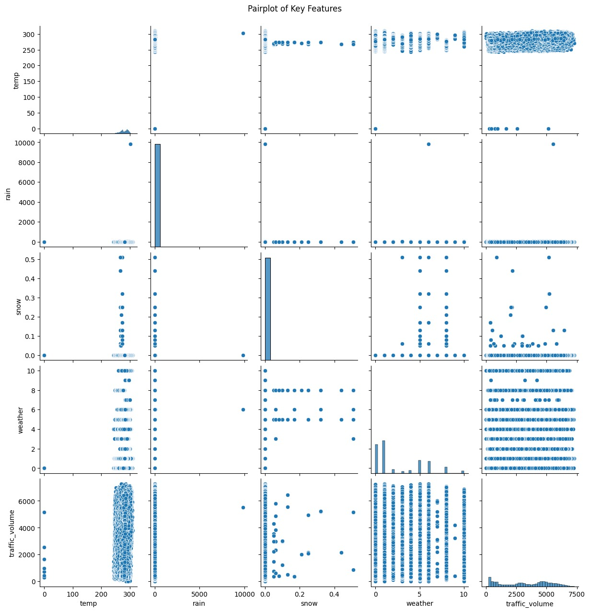
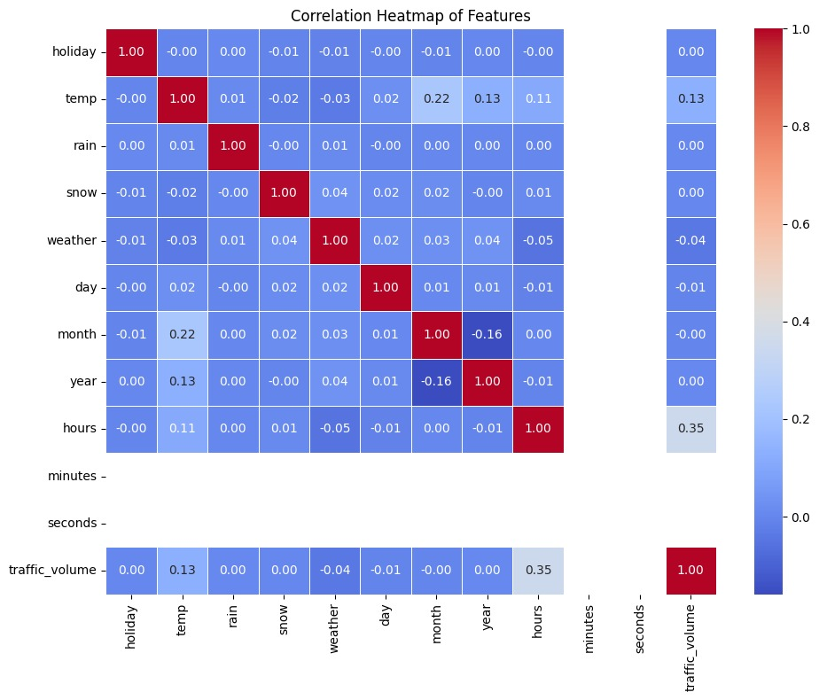

Slide 33

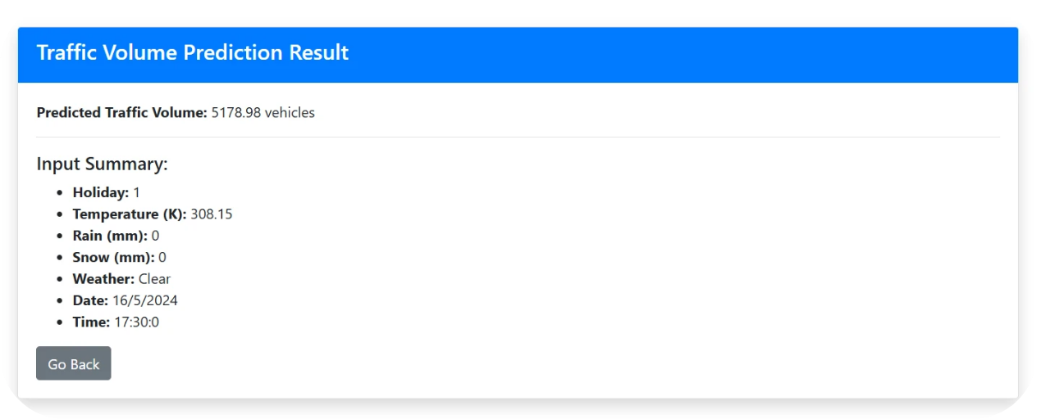
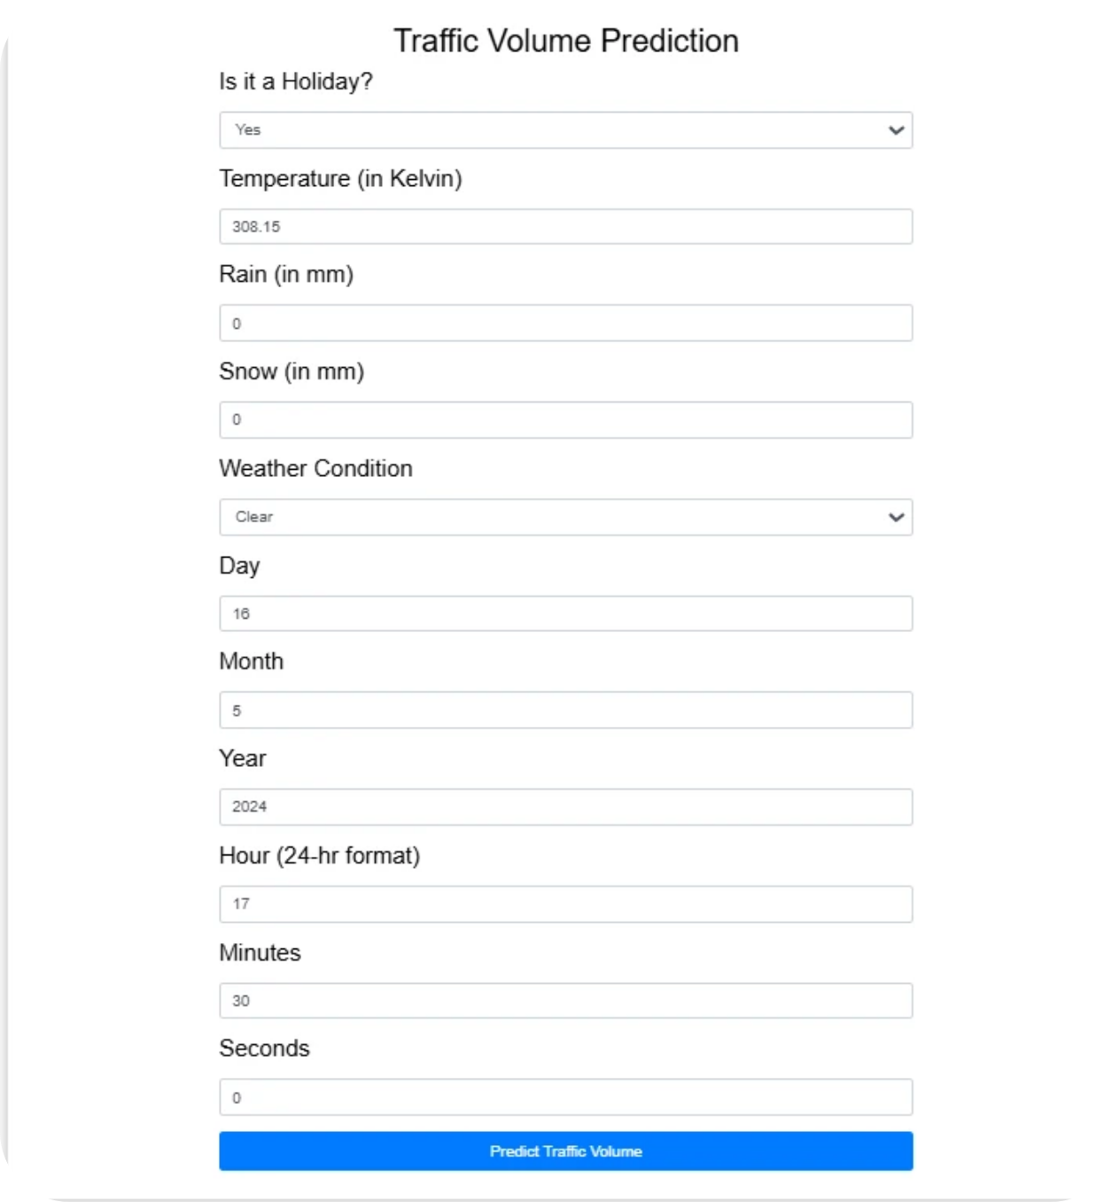
Output Screens
Prediction Result Display:
Input Form Interface:

Slide 34
07
RESULTS

Slide 35

RESULTS
1
2
3
4
User Inputs
Predictions Displayed
User Summary
Interface Validation
Inputs like weather, time, holiday status accepted via form
Summary of user inputs displayed with each output
Accurate predictions shown on result dashboard
Interface validated across multiple test scenarios

Slide 36

08
ADVANTAGES & DISADVANTAGES

Slide 37

ADVANTAGES & DISADVANTAGES
Advantages
• ML-powered predictions improve accuracy
• Cost-effective alternative to hardware sensors
• Scalable and extendable system
• Easy to use for both authorities and citizens
Disadvantages
• Accuracy depends on data quality
• Requires regular model updates with new trends

Slide 38
09
CONCLUSION

Slide 39
CONCLUSION
The project successfully demonstrates how machine learning can be applied to traffic forecasting. Its flexible design, interactive interface, and robust logic meet the intended objectives and make it suitable for real-world implementation.

Slide 40

10
FUTURE SCOPE

Slide 41

FUTURE SCOPE
1
2
3
4
Real-time data integration
Deploy system
Enhance prediction engine
Cloud integration
on mobile platform
and visualization dashboard
(live cameras, GPS feeds)
with deep learning (CNNs, RNNs)

Slide 42
Thank You

